Slide 1


Oscar Quiroga
2024-06-17

Slide 2

Outline
Executive Summary
Introduction
Methodology
Results
Conclusion
Appendix

Slide 3
Executive Summary
A series of exploratory analysis and predictive classification were done to landings of the first phase of the rocket launcher.
Accompanied with visualization in charts, graphs, dashboards and maps.
Some candidate landing sites, booster types and orbit types for future missions were found.

Slide 4
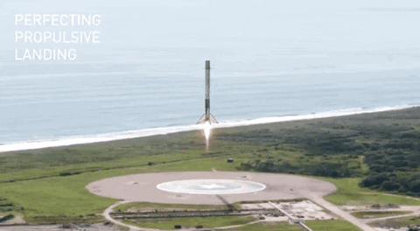
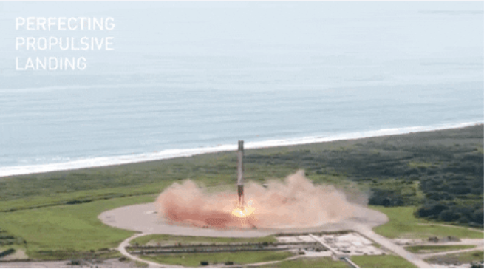
Introduction
SpaceX highly competitive because they can recover the first phase of the rocket launcher
We want to find the best parameters of a successful landing to predict the price of a landing of the first phase.

Slide 5

Section 1

Slide 6
Methodology
Executive Summary
Data collection methodology:
Data was collected from SpaceX Launch data own library and webscraping.
Perform data wrangling
Data was cleaned for missing values, preprocessed and new features were added for analysis
Perform exploratory data analysis (EDA) using visualization and SQL
Perform interactive visual analytics using Folium and Plotly Dash
Perform predictive analysis using classification models
Grid search was used with different methods evaluated using accuracy and confusion matrix splitting the data in training and test datasets.

Slide 7
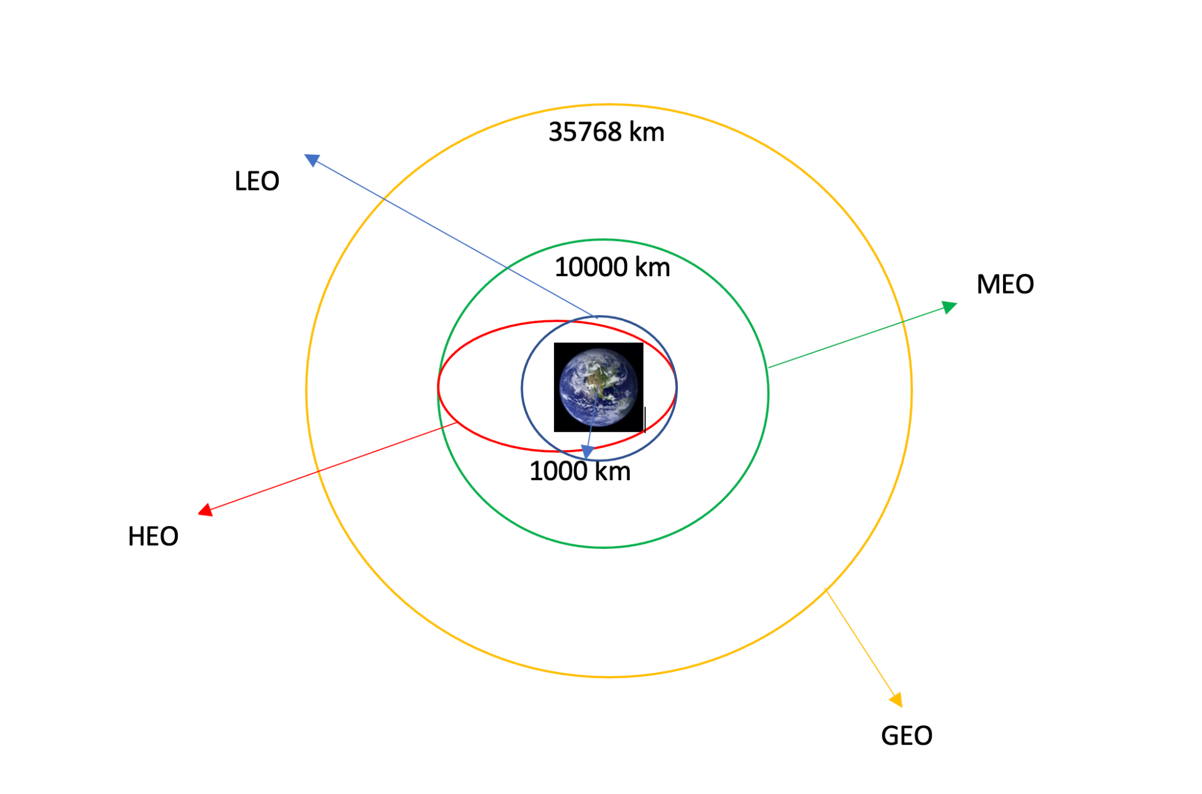
Data Collection
From the API and web scraping the fields were:
Launch site
Payload mass in Kg
Orbit: the target orbit
Date
Booster version
Launch Outcome
Booster landing
API URL: https://api.spacexdata.com/v4
Scraping source: https://en.wikipedia.org
Earth Orbits

Slide 8
Data Collection – SpaceX API
Filtering:
Launches with one payload
Falcon 9 launches only
Remove unnecessary fields
Joining fields: IDs used to extract fields from other tables in API
GitHub URL of data collection https://github.com/osjuquiga/IBM-Data-Sciene-Capstone/blob/main/jupyter-labs-spacex-data-collection-api.ipynb
API call to JSON
Pandas Dataframe
Filtering
Joining
Save to CSV

Slide 9
Data Collection - Scraping
Beautifulsoup to parse HTML
Data frame populated with iteration over all relevant HTML tables with launch entries
GitHub URL of webscrapping https://github.com/osjuquiga/IBM-Data-Sciene-Capstone/blob/main/jupyter-labs-webscraping.ipynb
HTTP response
Parse HTML
Populate Pandas dataframe
Save to CSV

Slide 10
Data Wrangling
EDA target labels for ML classification
From Collected SpaceX API
Null values replaced with mean of field.
Exploratory data analysis (EDA)
Data wrangling GitHub URL https://github.com/osjuquiga/IBM-Data-Sciene-Capstone/blob/main/labs-jupyter-spacex-Data%20wrangling.ipynb
Landing Outcome | Outcome Label
True ASDS | True
None None | False
True RTLS | True
False ASDS | False
True Ocean | True
False Ocean | False
None ASDS | False
False RTLS | False

Slide 11

EDA with Data Visualization
Fields Orbit, Year, Flight number, Launch Site and Payload were visualized against each other to find patterns in data.
Mostly Seaborn charts
Prepare data for feature engineering
GitHub URL https://github.com/osjuquiga/IBM-Data-Sciene-Capstone/blob/main/jupyter-labs-eda-dataviz.ipynb

Slide 12

EDA with SQL
Webscrapped data loaded into sqlite, Jupyter magic statements for querying
General Payload statistics about some clients like NASA, booster type and launch site. Also statistics in time.
Determine the cost of a launch if first stage will land.
GitHub URL https://github.com/osjuquiga/IBM-Data-Sciene-Capstone/blob/main/jupyter-labs-eda-sql-coursera_sqllite.ipynb

Slide 13

Build an Interactive Map with Folium
Markers and pop ups for launch locations
Find patterns in proximity to other nearby locations like beaches, railways or streets
Find success rate of location
GitHub URL of interactive map https://github.com/osjuquiga/IBM-Data-Sciene-Capstone/blob/main/jupyter-labs-spacex-data-collection-api.ipynb

Slide 14

Build a Dashboard with Plotly Dash
interactive dashboard with dropdown launching station and date ranges for successful launches
The dashboard focus on the most viable launching station in time.
GitHub URL of Plotly Dash https://github.com/osjuquiga/IBM-Data-Sciene-Capstone/blob/main/spacex_dash_app.py

Slide 15
Predictive Analysis (Classification)
Isolate features and target
A series of machine learning methods for classification, SVM, KNN, Logistic regression and decision trees were tested
One hot vector for categorical variables
GitHub URL predictive analysis lab https://github.com/osjuquiga/IBM-Data-Sciene-Capstone/blob/main/SpaceX_Machine_Learning_Prediction_Part_5.jupyterlite.ipynb
Train classificator
Evaluate
Best?
No
Yes
Use model

Slide 16

Section 2

Slide 17
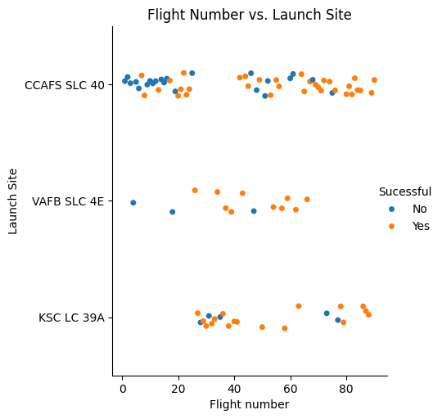
Flight Number vs. Launch Site
There is a gap of launches around number 20 and 40
Launch site KSC LC 39A has a high ratio of successful launches

Slide 18
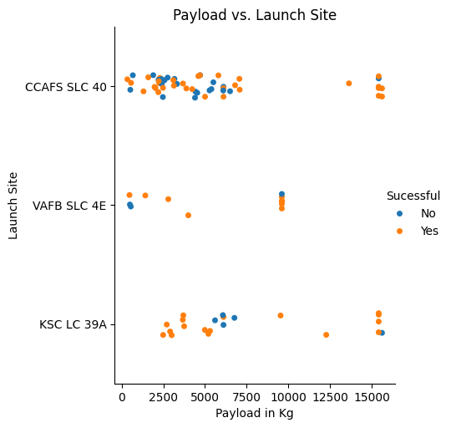
Payload vs. Launch Site
VAFB SLC 4E was not used with high payloads
CCAFS SLC 40 was highly used for low payloads

Slide 19
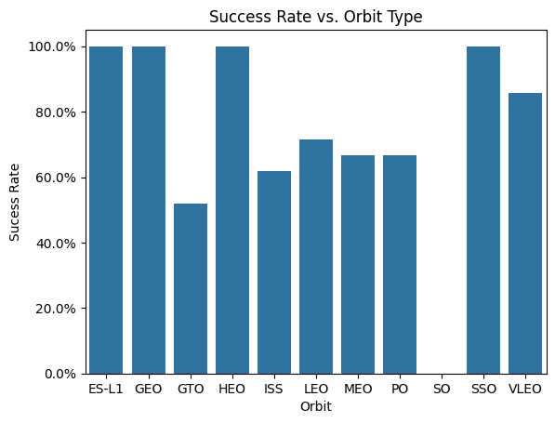
Success Rate vs. Orbit Type
VLEO and SSO have the highest rate of success, the other 100% orbits lack samples
One launch was to SO orbit and it failed.

Slide 20
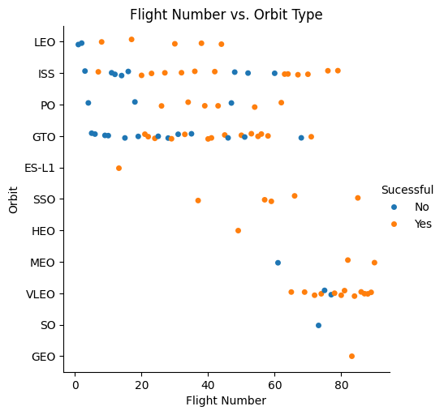
Flight Number vs. Orbit Type
Latter flights were done in VLEO orbit with a high success rate
Earlier flights were done in LEO orbit

Slide 21
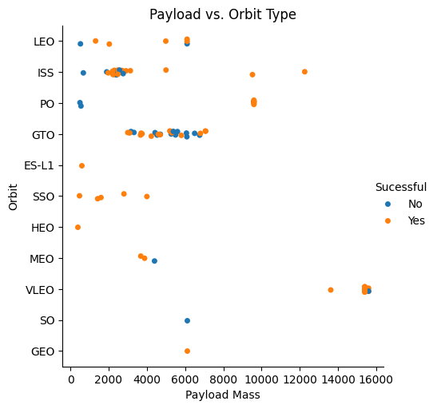
Payload vs. Orbit Type
With heavy payloads the successful landing rate is more for Polar,LEO and ISS.
GTO we cannot distinguish this well as both positive landing rate and negative

Slide 22
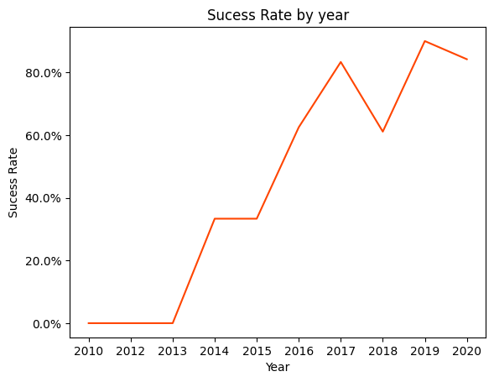
Launch Success Yearly Trend
The success rate since 2013 kept increasing till 2017 (stable in 2014) and after 2015 it started increasing.

Slide 23
All Launch Site Names
%sql select DISTINCT(Launch_Site) from spacextable
There are 4 unique launch sites
Launch_Site
CCAFS LC-40
VAFB SLC-4E
KSC LC-39A
CCAFS SLC-40

Slide 24
Launch Site Names Begin with 'CCA'
%sql select * from spacextable where Launch_Site like 'CCA%' limit 5
These are early launches with NASA as clients with failed landings
Date | Time (UTC) | Booster_Version | Launch_Site | Payload | PAYLOAD_MASS__KG_ | Orbit | Customer | Mission_Outcome | Landing_Outcome
2010-06-04 | 18:45:00 | F9 v1.0 B0003 | CCAFS LC-40 | Dragon Spacecraft Qualification Unit | 0 | LEO | SpaceX | Success | Failure (parachute)
2010-12-08 | 15:43:00 | F9 v1.0 B0004 | CCAFS LC-40 | Dragon demo flight C1, two CubeSats, barrel of Brouere cheese | 0 | LEO (ISS) | NASA (COTS) NRO | Success | Failure (parachute)

Slide 25
Total Payload Mass
Over 45000 kg has been launched to space with one payload per launch for NASA (CRS) customer
This NASA customer requires high payloads
%sql select sum(payload_mass__kg_) as Total_payload_mass__kg from spacextable where customer = "NASA (CRS)"
Total_payload_mass__kg
45596

Slide 26
Average Payload Mass by F9 v1.1
On average a payload with F9 booster v1.1 is 2928.4 Kg
This booster deals with low payloads on average
%%sql
select avg(payload_mass__kg_) as mean_payload_mass_kg
from spacextable where booster_version like 'F9 v1.1'
Mean_payload_mass_kg
2928.4

Slide 27
First Successful Ground Landing Date
SpaceX started launching in 2010
It took 5 years to get a successful landing
%sql select min(date) as Date from spacextable where Landing_Outcome = 'Success (ground pad)'
Date
2015-12-22

Slide 28
Successful Drone Ship Landing with Payload between 4000 and 6000
%%sql select Booster_Version from spacextable
where
payload_mass__kg_ > 4000 and
payload_mass__kg_ < 6000 and
Landing_Outcome = 'Success (drone ship)'
There are 4 versions of boosters with average payloads
Booster_Version
F9 FT B1022
F9 FT B1026
F9 FT B1021.2
F9 FT B1031.2

Slide 29
Total Number of Successful and Failure Mission Outcomes
%sql select Mission_Outcome, count(*) as frequency from spacextable group by Mission_Outcome
Almost all missions have been successful flying payloads to their destination
Mission_Outcome | frequency
Failure (in flight) | 1
Success | 98
Success | 1
Success (payload status unclear) | 1

Slide 30
Boosters Carried Maximum Payload
%%sql
select Booster_Version from spacextable
where payload_mass__kg_ = (
select max(payload_mass__kg_) from spacextable
)
F9 B5 B series are the ones used to carry the maximum heaviest payloads.
Booster_Version
F9 B5 B1048.4
F9 B5 B1049.4
F9 B5 B1051.3
F9 B5 B1056.4
F9 B5 B1048.5
F9 B5 B1051.4
F9 B5 B1060.2
F9 B5 B1058.3
F9 B5 B1051.6
F9 B5 B1060.3
F9 B5 B1049.7

Slide 31
2015 Launch Records
month | Booster_Version | Launch_Site
01 | F9 v1.1 B1012 | CCAFS LC-40
02 | F9 v1.1 B1013 | CCAFS LC-40
03 | F9 v1.1 B1014 | CCAFS LC-40
04 | F9 v1.1 B1015 | CCAFS LC-40
04 | F9 v1.1 B1016 | CCAFS LC-40
06 | F9 v1.1 B1018 | CCAFS LC-40
12 | F9 FT B1019 | CCAFS LC-40
The year 2015 the successful landings where F9 v1.1 B series with launching site CCAFS LC-40

Slide 32
Rank Landing Outcomes Between 2010-06-04 and 2017-03-20
Landing_Outcome | frequency
No attempt | 10
Success (drone ship) | 5
Failure (drone ship) | 5
Success (ground pad) | 3
Controlled (ocean) | 3
Uncontrolled (ocean) | 2
Failure (parachute) | 2
Precluded (drone ship) | 1
The 2 landings with parachutes failed
And using a drone ship for landing has the same odds of failing and succeeding
Ocean and ground pads all are successful

Slide 33

Section 3

Slide 34
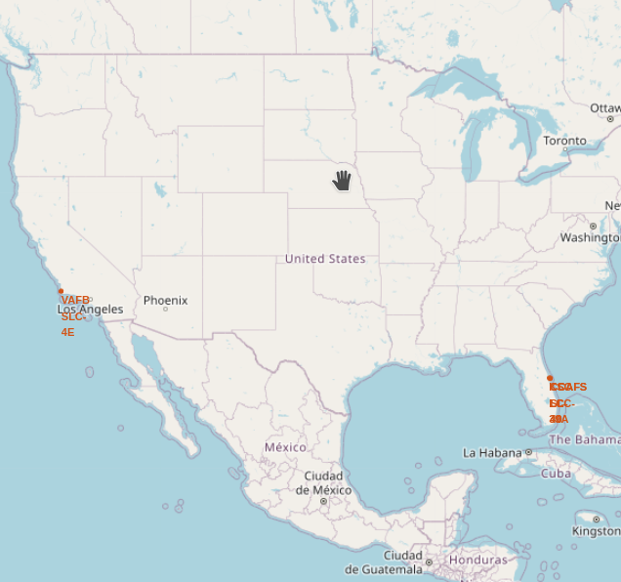
Launching sites SpaceX
1 Launching site is located in California.
3 are crumpled up in Florida at the other side of the continent.
Very close to the equator and near an ocean.

Slide 35
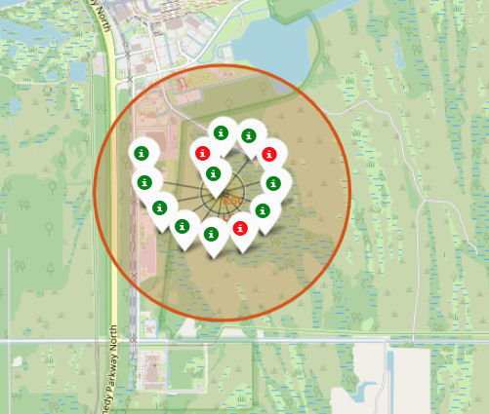
Success/Failure of KSC LC-39A
The site is inside a natural park, also has a high success rate compared to the other sites.

Slide 36
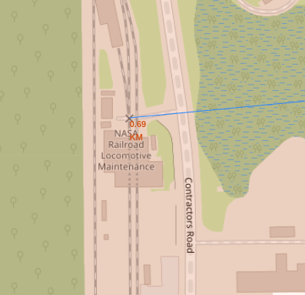
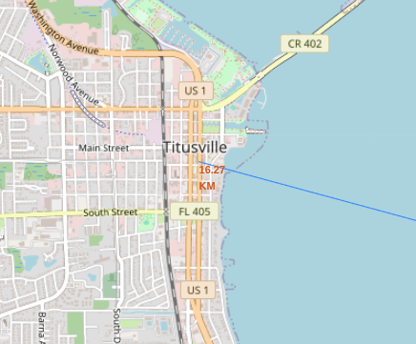
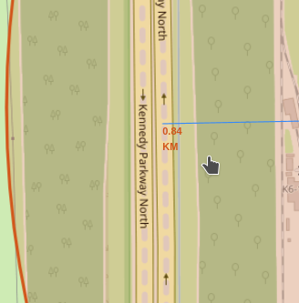
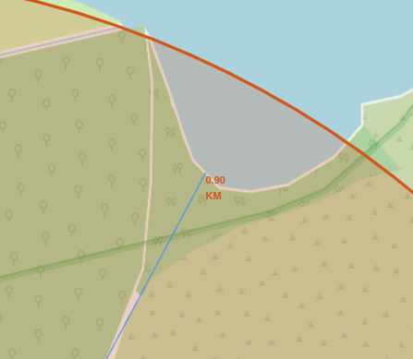
Landmarks of KSC LC-39A
This launch site has pretty close access to railways and highways, less than 1Km
The closest body of water is less than 1Km
The closest city is far away, around 14Km

Slide 37

Section 4

Slide 38
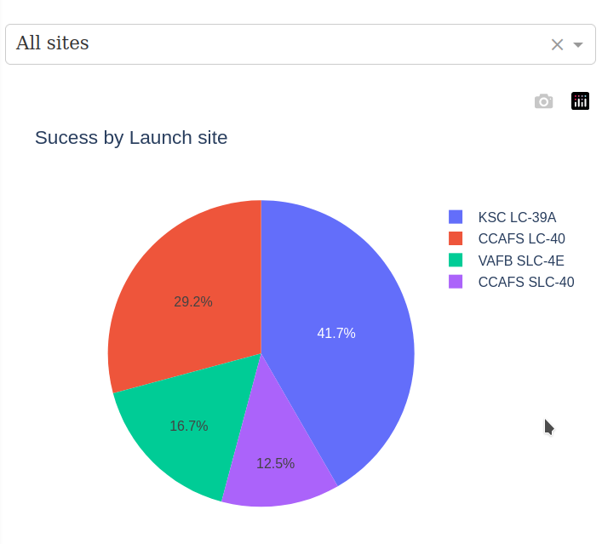
Success Landing by Launch Site
KSC LC-39A Launch site has the most success rate, 41.7%
CCAFS SLC-40 has the lowest success rate, 12.5%

Slide 39
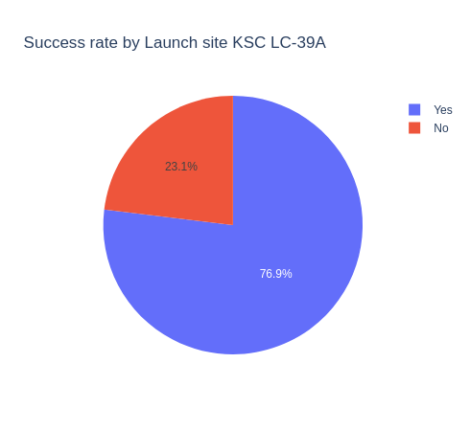
Success Landing of KSC LC-39A
Almost 3 of 4 landings have been successful at KSC LC-39A

Slide 40
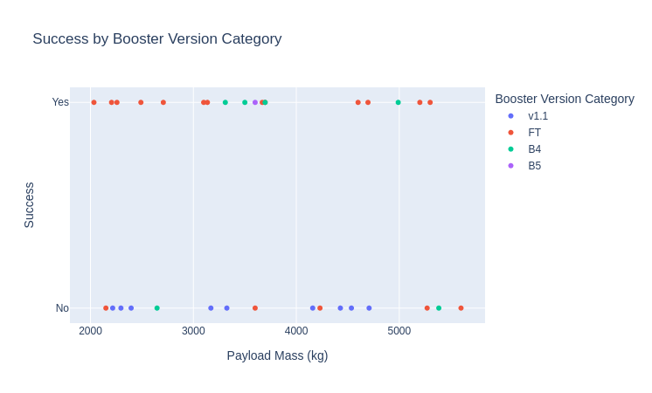
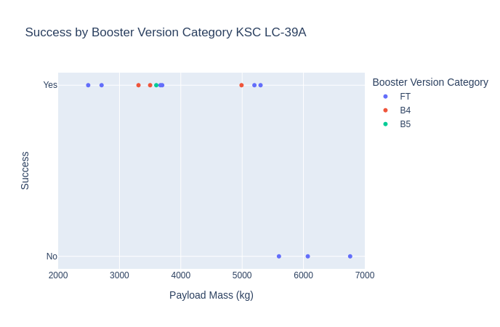
Success by Booster version
The booster with the highest rate of success is B4
For launch site KSC LC-39A the FT booster is less successful with payloads above 5500kg

Slide 41

Section 5

Slide 42
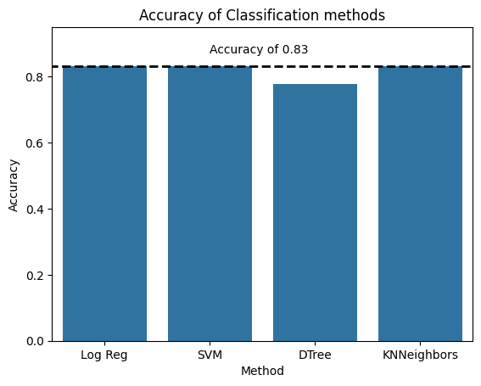
Classification Accuracy for Landing success
Only the decision tree didn’t reach the max accuracy of 0.83
Train/Test split for accuracy
Logistic regression was chosen because it also provides probability predictions

Slide 43
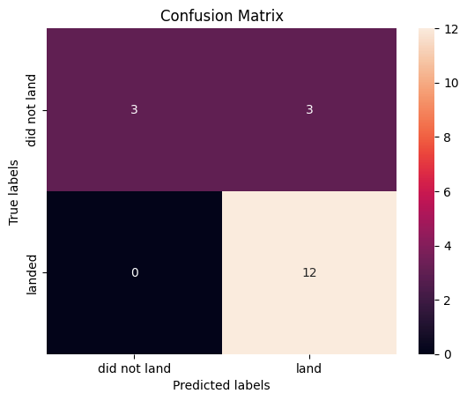
Confusion Matrix of Logistic Regression
The model has a precision of 100% for landings
50% for unsuccessful landings, model is not good for predicting a failed landing.

Slide 44
Conclusions
The best landing site is KSC LC-39A located in Florida, USA with highways and railways less than 1km away
The best booster type is B4 in the above location
With available data, the prediction model is best suited to predict successful landings but not failed landings
The best orbit to target is VLEO, though others have higher success rate, there’s not enough data

Slide 45


